Slide 1

Exception Handling
.Net

Slide 2
The C# language's exception handling features help you deal with any unexpected or exceptional situations that occur during runtime. Exception handling uses the try, catch, and finally keywords to try actions that may not succeed.
https://docs.microsoft.com/en-us/dotnet/csharp/programming-guide/exceptions/exception-handling

Slide 3
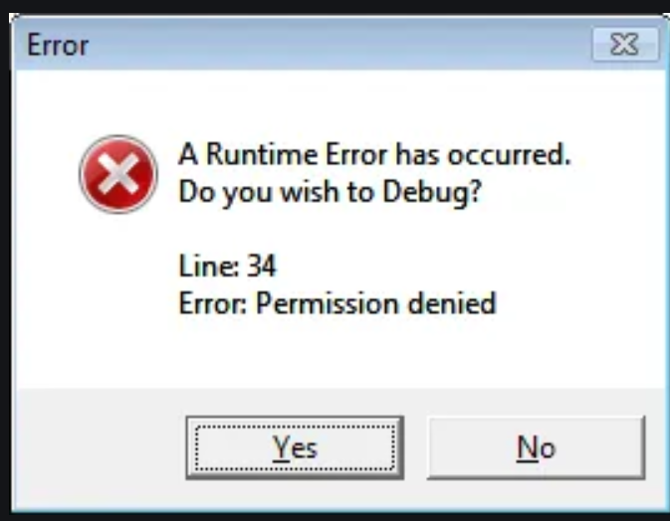
Exceptions vs. Errors https://docs.microsoft.com/en-us/dotnet/api/system.exception?view=net-5.0#errors-and-exceptions
Run-time errors can occur for a variety of reasons, but not all errors should be handled as exceptions in your code. There are three main types of run-time errors:
Usage Errors
An error in program logic that should be addressed not through exception handling but by modifying the faulty code.
Program Errors
a run-time error that cannot necessarily be avoided by writing bug-free code.
System Failures
a run-time error that cannot be handled programmatically in a meaningful way.

Slide 4
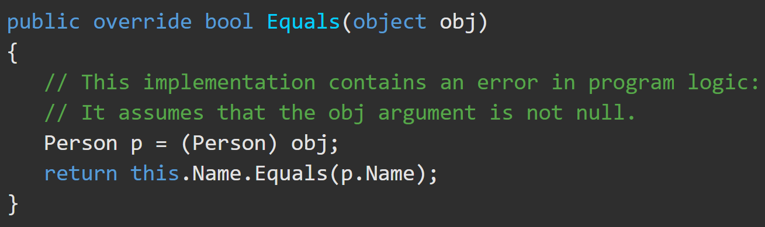
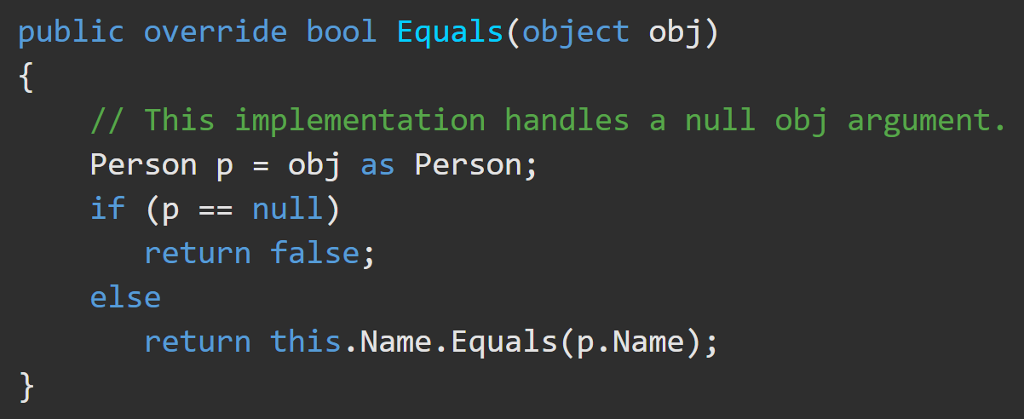
Errors – Usage Errors https://docs.microsoft.com/en-us/dotnet/api/system.exception?view=net-5.0#errors-and-exceptions
Usage errors occur due to faulty program logic and should be addressed though correction of the code rather than in handling an exception when it’s thrown.
The override of the Object.Equals(Object) method in the following example assumes that the obj argument must always be non-null.
These errors should be caught in development and handled with thrown exceptions so that the code can be corrected before deployment.

Slide 5
Program Errors, System failures https://docs.microsoft.com/en-us/dotnet/api/system.exception?view=net-5.0#errors-and-exceptions
Program Errors –
May reflect a routine error condition. Avoid using exception handling to deal with program errors. Instead prevent the exception by trying the action first.
USE => DateTime.TryParseExact (returns a Boolean)
DO NOT USE => DateTime.ParseExact (throws a FormatException exception)
System failures –
Should not be handled by using exception handling. Any method can throw an OutOfMemoryException class exception if the CLR is unable to allocate additional memory. You may be able to use an event such as AppDomain.UnhandledException and call the Environment.FailFast method to notify the user before the application terminates.

Slide 6
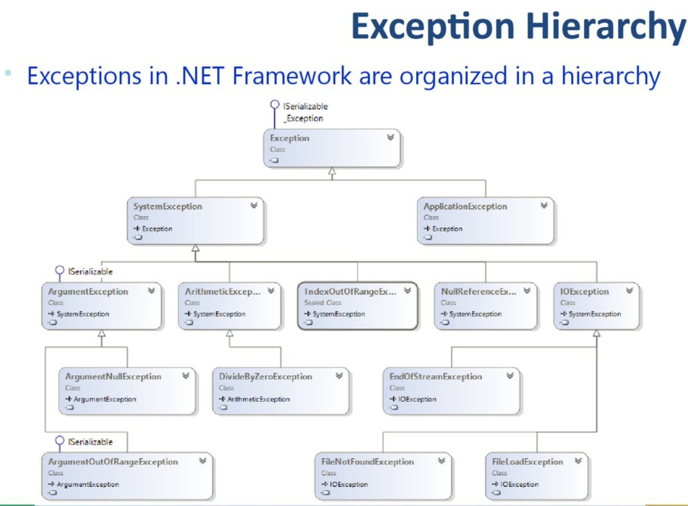
Exception Class https://docs.microsoft.com/en-us/dotnet/csharp/programming-guide/exceptions/
The Exception Class is the base class for all exceptions. When any error occurs, the system or the application throws an exception that contains information about the error.
When an exception is thrown by a method far down the call stack, the CLR will unwind the stack, looking for a method with a catch block for that specific exception type and execute the first matching catch block. If it finds no catch block in the call stack, it terminates the process and displays a message to the user.

Slide 7
Exception Class – Hierarchy https://en.ppt-online.org/89884
All exceptions inherit from the Exception Class.
All run-time exceptions inherit from the SystemException Class.

Slide 8
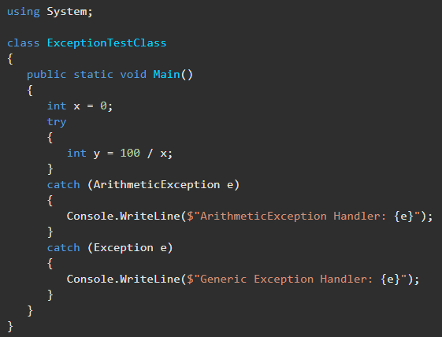
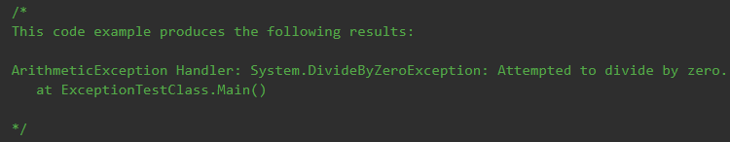
Exception Example https://docs.microsoft.com/en-us/dotnet/api/system.exception?view=net-5.0#examples
This catch block will handle ArithmeticException and DivideByZeroException errors because DivideByZeroException derives from ArithmeticException.
Without the exception handling, this program would terminate with the ‘DivideByZeroException was unhandled’ error.

Slide 9
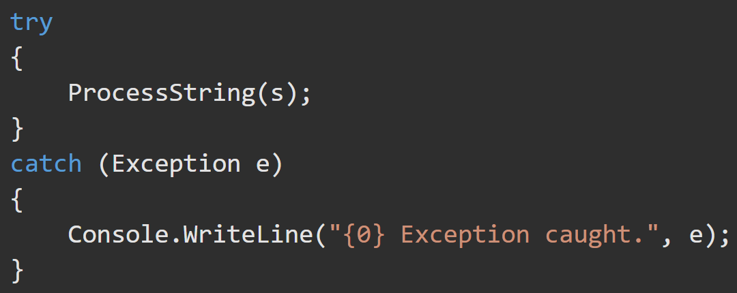
Exceptions – Try/Catch Block https://docs.microsoft.com/en-us/dotnet/csharp/language-reference/keywords/try-catch
Generally, when an exception is thrown, the CLR unwinds the stack looking for the appropriate catch statement. If no catch block is found, then the CLR displays an unhandled exception message to the user and stops execution of the program.
The try/catch statement consists of a try block followed by one or more catch blocks. Catch blocks specify different exceptions. The try block contains the code that may cause the exception. The block is executed until an exception is thrown or it is completed successfully.
Using multiple catch arguments is a way to filter for the exceptions you want to handle.

Slide 10
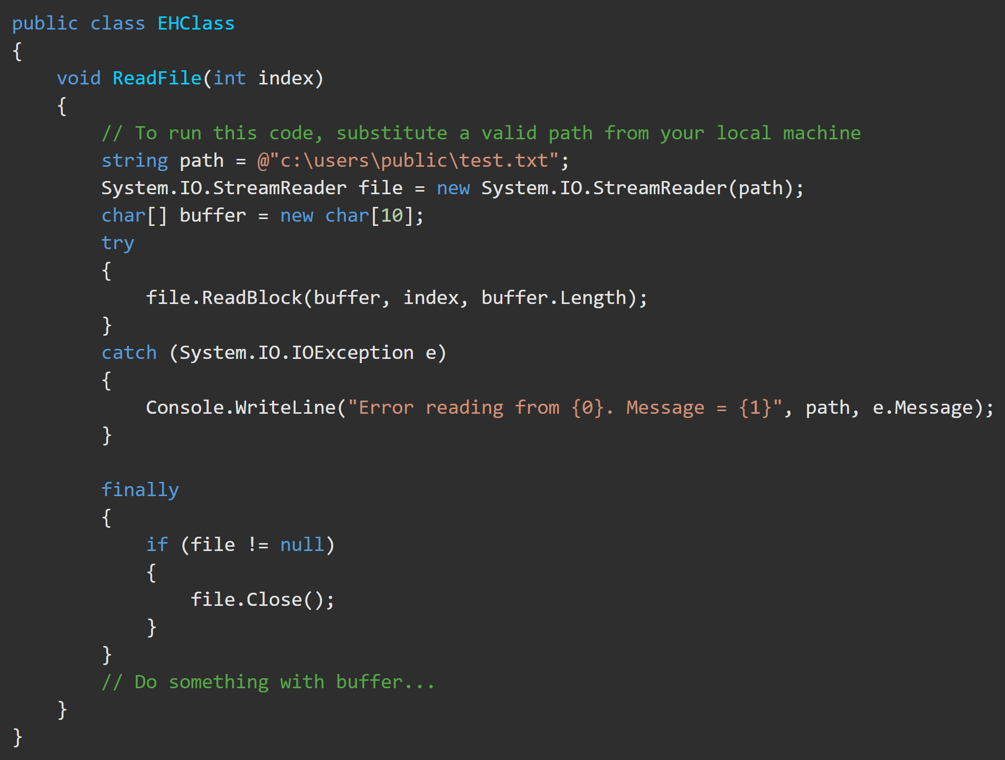
Exceptions - Try/Catch/Finally https://docs.microsoft.com/en-us/dotnet/csharp/language-reference/keywords/try-catch-finally
Usage of try/catch/finally block is to:
obtain and use resources in a try block
deal with exceptional circumstances in a catch block
release the resources in the finally block
The finally block always runs.

Slide 11
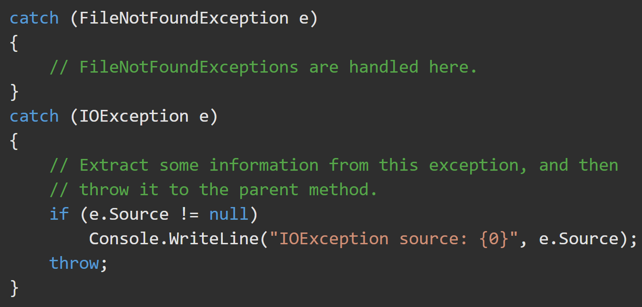
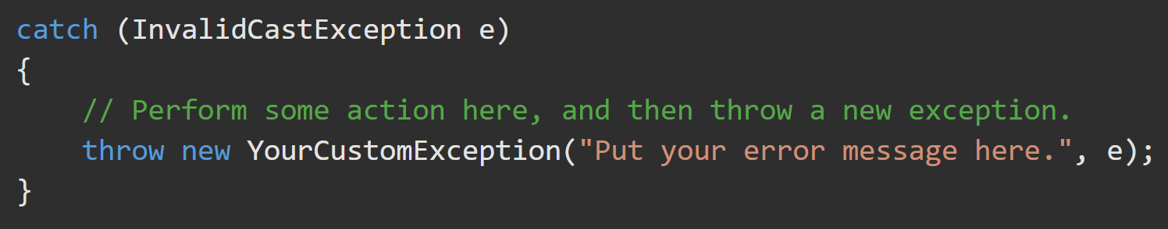
Exceptions - Throw https://docs.microsoft.com/en-us/dotnet/csharp/language-reference/keywords/throw https://docs.microsoft.com/en-us/dotnet/csharp/language-reference/keywords/try-catch
A throw statement can be used in a catch block to re-throw the exception that is caught by the catch statement so that the next method up the stack receives it, too.
You can catch one exception and throw a different exception. When you do this, specify the exception that you caught as the inner exception, as shown in the following example.

Slide 12
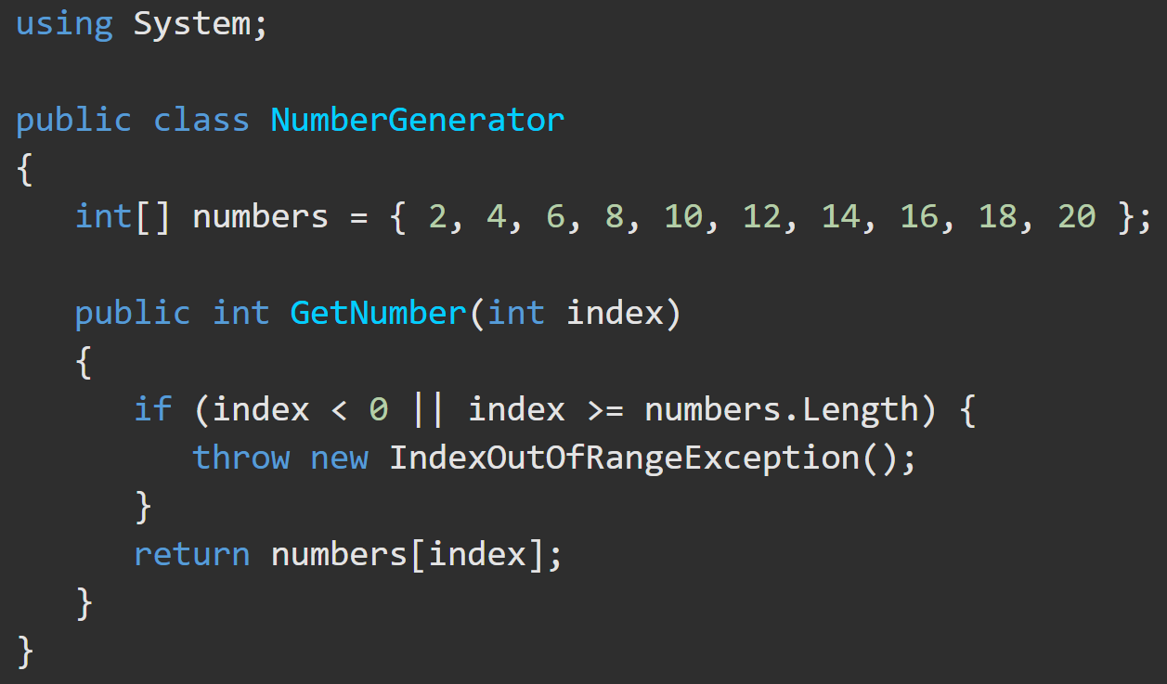
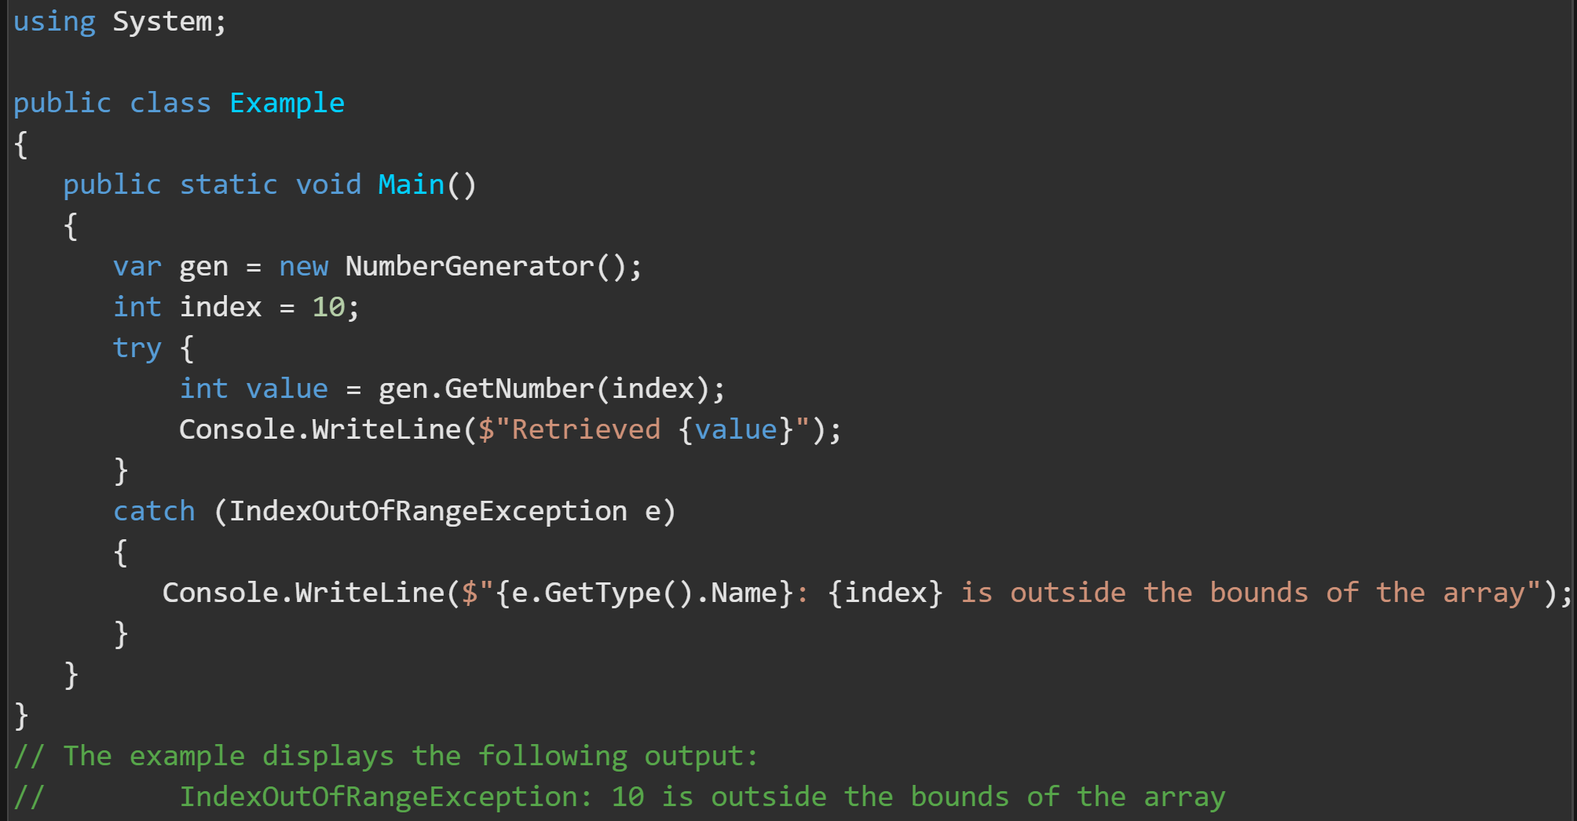
Exceptions ‘throw’ and Unwind The Stack https://docs.microsoft.com/en-us/dotnet/csharp/language-reference/keywords/throw

Slide 13
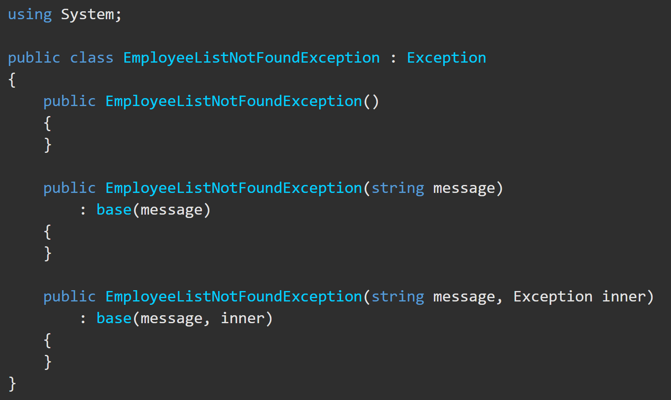
User-Defined Exceptions https://docs.microsoft.com/en-us/dotnet/standard/exceptions/how-to-create-user-defined-exceptions
To create custom exceptions, you must:
create your own exception classes
Derive(inherit) from the Exception class.
End the class name with the word "Exception“.
Implement the three common constructors(example).

Slide 14
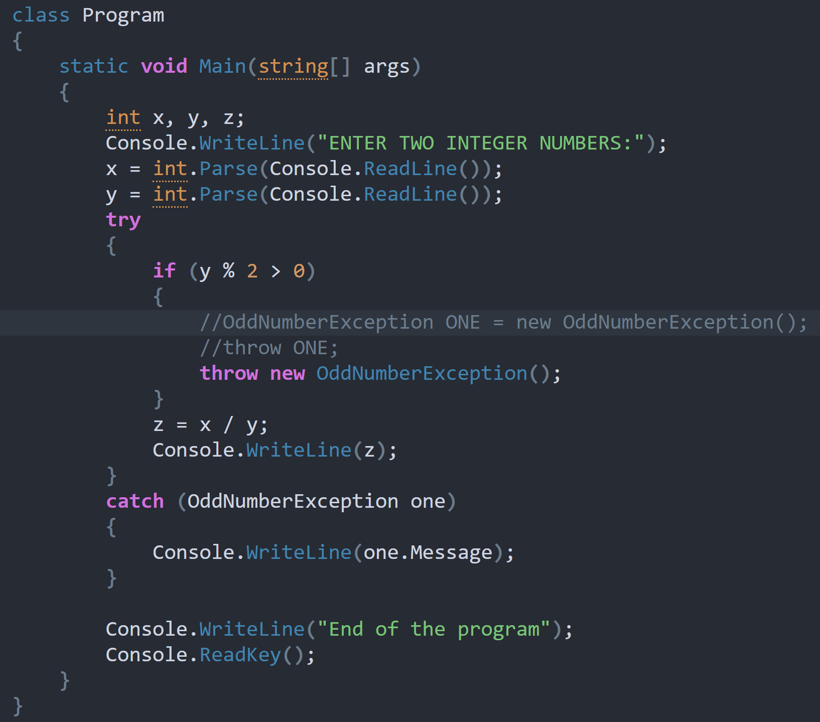
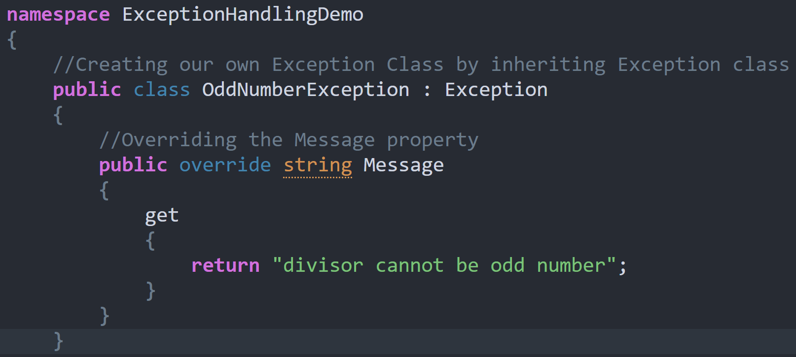
Custom Exceptions https://dotnettutorials.net/lesson/create-custom-exception-csharp/#:~:text=
Create a new class inheriting from Exception.
Override Exception’s virtual property (Message()) with your chosen error message.
Throw the custom exception manually.

